Slide 1

Raspberry Pi
The Affordable, Sized Computer
Done by
Aniverthy
1DA21CS022

Slide 2
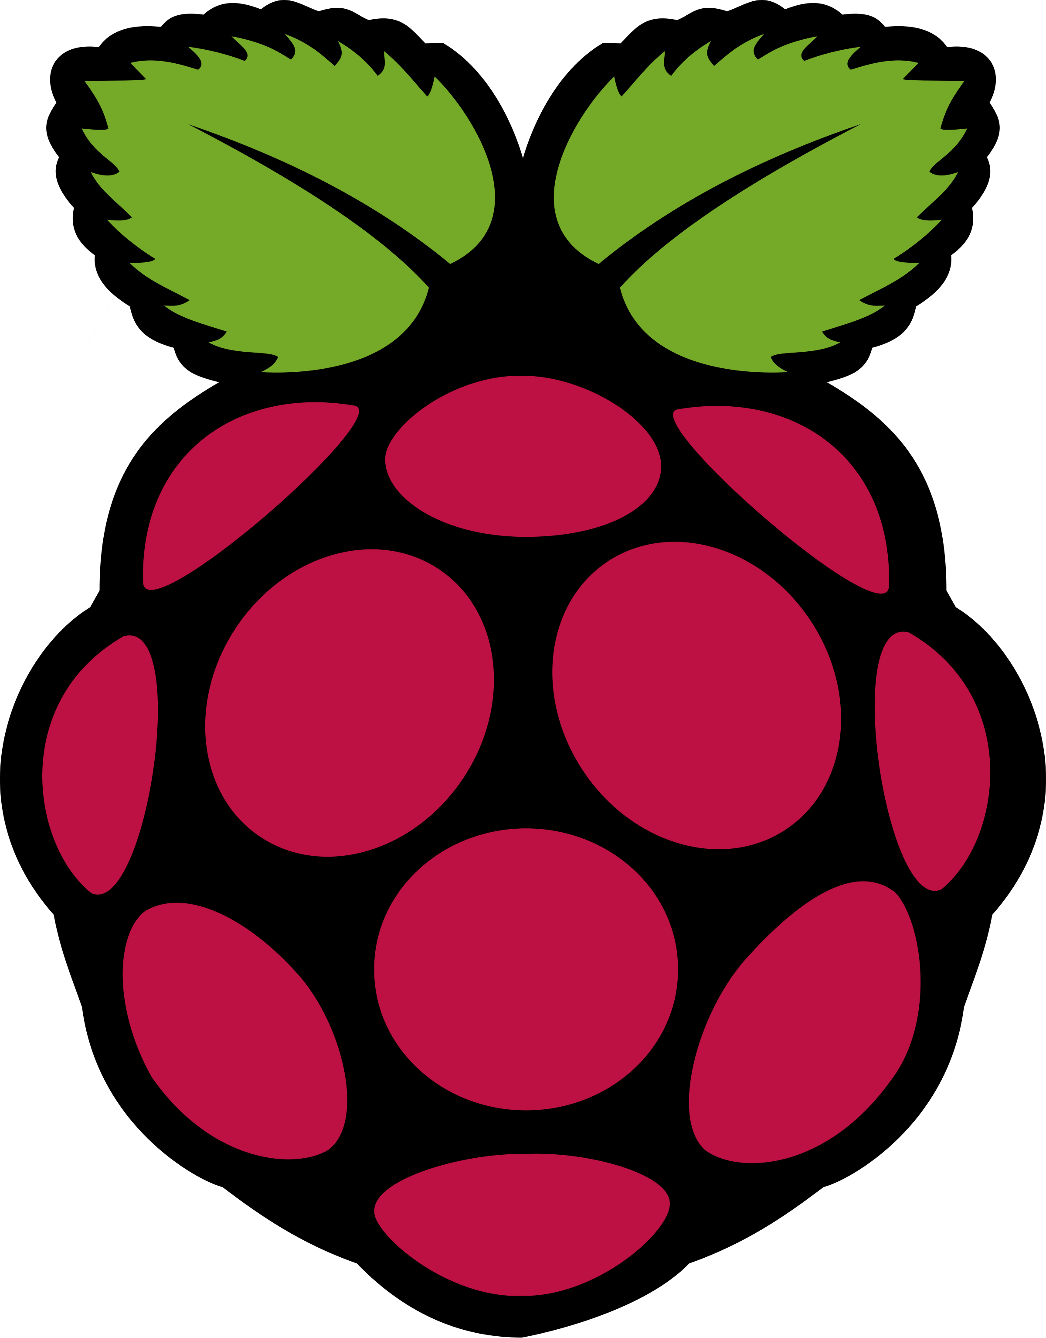
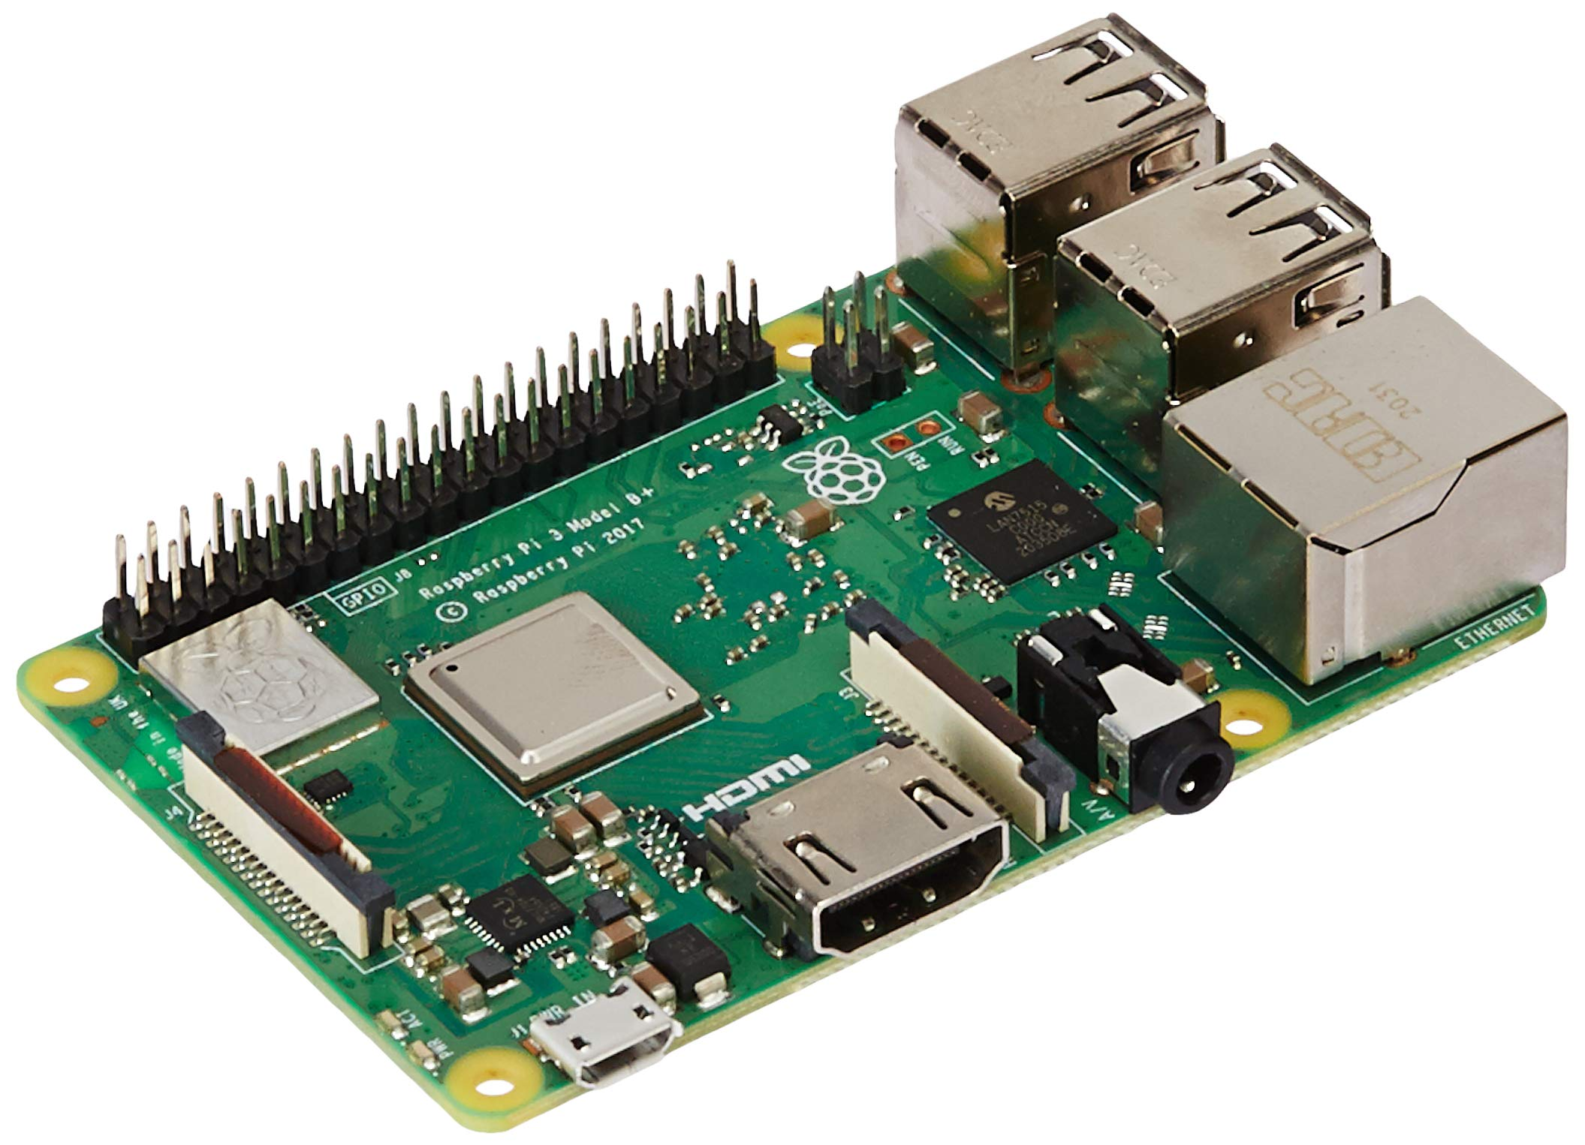
What is Raspberry Pi ?
Raspberry Pi is a low-cost, single-board computer (SBC) that's about the size of a credit card
Purpose
The Raspberry Pi was developed to make computer science more accessible and affordable. It's used by people of all ages to learn how to program and explore computing.
Uses
The Raspberry Pi is used for a variety of purposes, including:
Robotics
Home automation
Industrial automation
Computer and electronic hobbyists

Slide 3
History and Evolution
The Raspberry Pi was originally developed in the UK by the Raspberry Pi Foundation in association with Broadcom. The original model became more popular than expected, selling outside its target market. In 2012, it became the best-selling British computer.
The name Raspberry Pi comes from the bold color of the raspberry and the word "Pi" as a play on the word "Python".
Family | Model
Raspberry Pi | B
 | A
 | B+
 | A+
Raspberry Pi 2 | B
Raspberry Pi Zero | Zero
 | W / WH
 | 2 W
Raspberry Pi 3 | B
 | A+
 | B+
Raspberry Pi 4 | B
 | 400
Raspberry Pi Pico | Pico
 | W
 | 2
Raspberry Pi 5
Timeline of Raspberry Pi Models:
2012: Raspberry Pi 1 (Model A & B)
2015: Raspberry Pi 2
2016: Raspberry Pi 3
2019: Raspberry Pi 4
2020: Raspberry Pi Pico
2023: Raspberry Pi 5

Slide 4
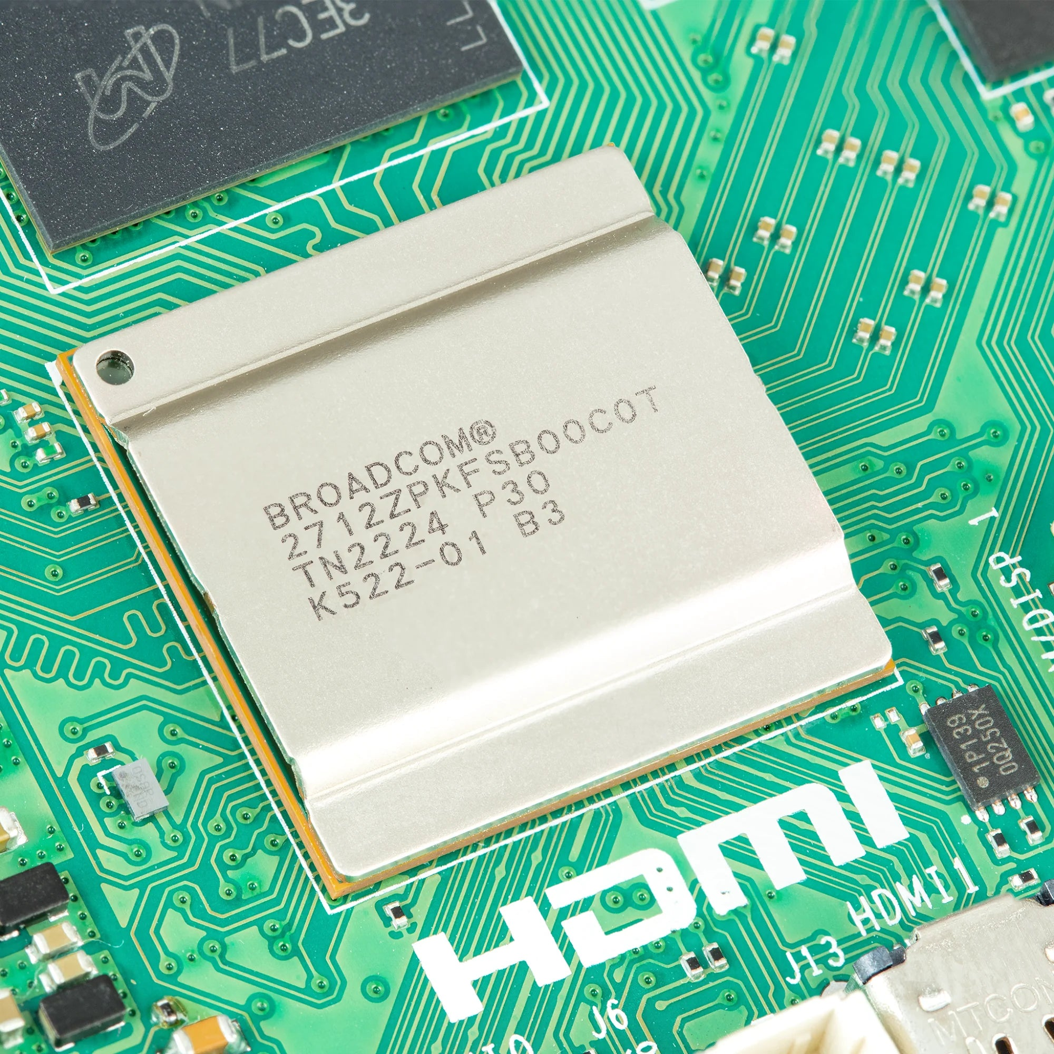
Technical Specifications
Processor: Broadcom BCM2712 2.4GHz quad-core 64-bit Arm Cortex-A76 CPU
Memory: LPDDR4X-4267 SDRAM with options for 2GB, 4GB, or 8GB
Connectivity:
Dual-band 802.11ac Wi-Fi and Bluetooth 5.0 / BLE
Gigabit Ethernet with PoE+ support (requires separate PoE+ HAT)
Storage: MicroSD card slot with high-speed SDR104 mode
Power: USB-C power supply: 5V/5A with Power Delivery support
Reference: https://datasheets.raspberrypi.com/rpi5/raspberry-pi-5-product-brief.pdf

Slide 5
Technical Specifications
I/O Ports:
USB Ports:
2 × USB 3.0 (supporting simultaneous 5Gbps operation)
2 × USB 2.0
Camera/Display:
2 × 4-lane MIPI camera/display transceivers
PCIe Interface:
PCIe 2.0 x1 for fast peripherals (requires separate adapter)
Graphics & Video:
VideoCore VII GPU, supporting OpenGL ES 3.1 and Vulkan 1.2
Dual 4Kp60 HDMI display output with HDR support
4Kp60 HEVC hardware decoder
Additional Features:
Standard 40-pin GPIO header
Real-Time Clock (RTC) powered by an external battery
Power button for easy control
Production Lifetime:
Guaranteed production until at least January 2036
Reference: https://datasheets.raspberrypi.com/rpi5/raspberry-pi-5-product-brief.pdf

Slide 6
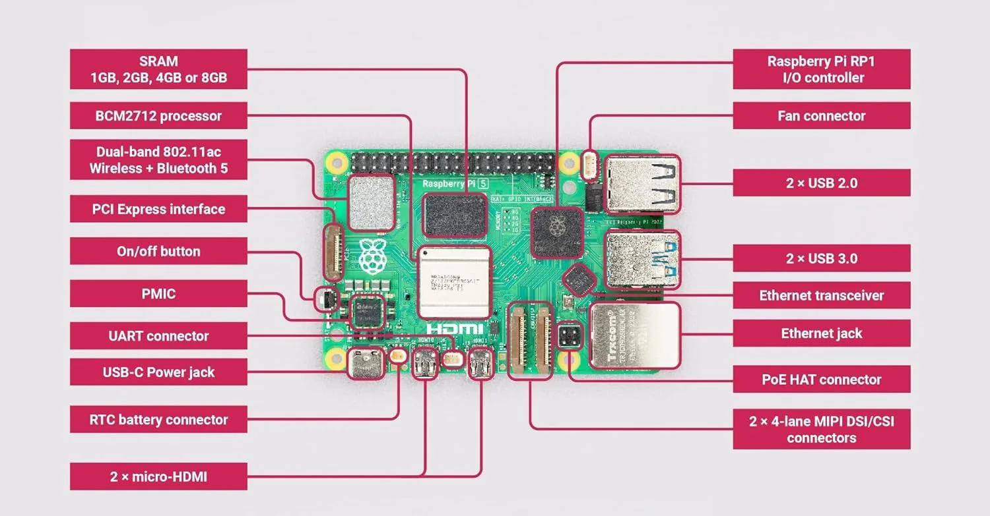
Raspberry pi 5 board
Reference: https://datasheets.raspberrypi.com/rpi5/raspberry-pi-5-product-brief.pdf

Slide 7
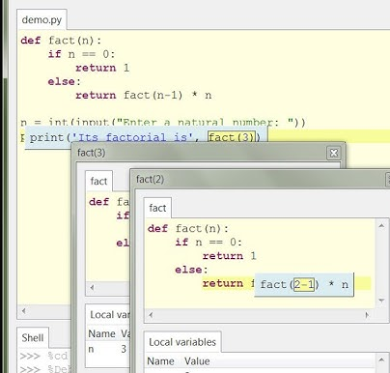
Programming with Raspberry Pi
Supported Languages
Python, C/C++, Java, Scratch, Node.js, Ruby
Operating Systems
Raspberry Pi OS (Debian-based, optimized for Pi 5)
Ubuntu, Windows IoT Core, RetroPie
Development Tools
IDEs: Thonny (Python), VS Code, PyCharm, Geany, IDLE
Features:
GPIO programming with RPi.GPIO and gpiozero
Dual 4K display support for visualization
Accelerated AI with TensorFlow Lite

Slide 8
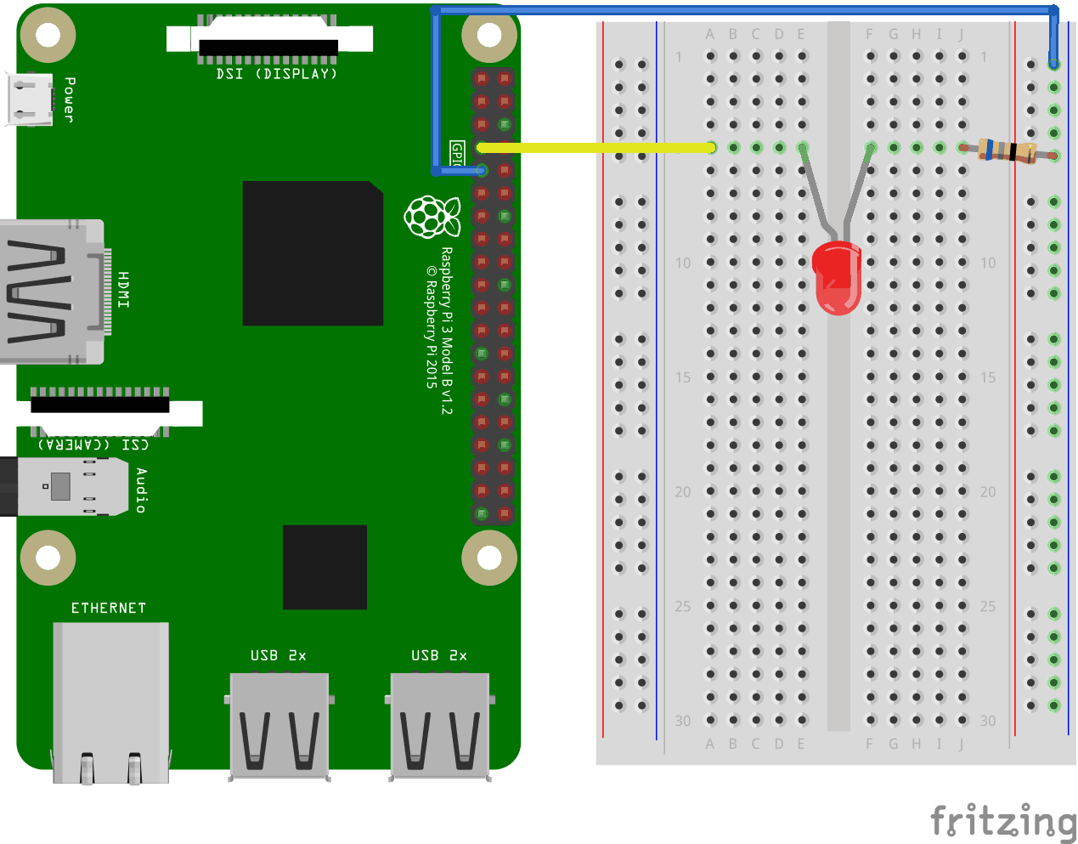
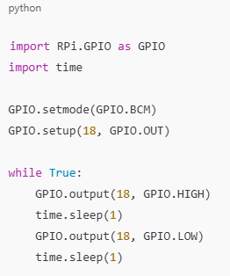
Programming with Raspberry Pi
Sample Code: Blink an LED

Slide 10
Current Applications of Raspberry Pi 5
Space Research: Used in programs like the European Astro Pi Challenge to run experiments aboard the ISS.
Portable Health Monitoring: Non-invasive devices for monitoring vitals like heart rate and oxygen levels.
DIY Kits: Encouraging hands-on learning for students through robotics and automation projects.
Home Media Servers: Hosting and streaming personal content using software like Plex.Gaming
Consoles: Emulating classic games with RetroPie.
Smart Agriculture: Raspberry Pi-powered irrigation systems in India and Africa.
Google AIY Projects: Custom AI solutions using Raspberry Pi.

Slide 11
Why Raspberry Pi Stands Out?
1. Cost-Effectiveness:
Affordable compared to alternatives like Arduino with shields or Intel NUCs.
Models start as low as $5 (Pico) and offer high performance for the price.
2. Versatility:
Functions as a mini-PC, IoT device, robotics controller, or media center.
Supports multiple operating systems (Raspberry Pi OS, Ubuntu, etc.).
3. Broad Community Support:
Extensive online forums, tutorials, and open-source projects.
Easily accessible libraries and tools for development.
4. Performance and Hardware Features:
Latest models (e.g., Raspberry Pi 5):
Quad-core CPU, dual 4K output, PCIe support, and AI acceleration.
Better memory options (up to 8GB) than most microcontrollers.
5. Compatibility with Peripherals:
Standard GPIO pins and support for sensors, cameras, and displays.
USB, Ethernet, and Wi-Fi/Bluetooth for enhanced connectivity.
6. Ease of Use:
Pre-installed software (Raspberry Pi OS) makes it beginner-friendly.
Plug-and-play setup, ideal for all skill levels.
7. Rich Ecosystem:
Hardware Kits: Available from trusted brands like CanaKit and Vilros.
Accessories: Camera modules, HATs, and PoE adapters expand functionality.
8. Real-World Adoption:
Widely used in education, IoT, healthcare, and research projects.
Trusted by industries for prototyping and deployment.
9. Sustainable Production:
Long production lifetimes (e.g., Raspberry Pi 5 guaranteed until 2036).
Energy-efficient, reducing power costs and environmental impact.

Slide 12
Comparison to Alternatives
Feature | Raspberry Pi | Arduino | BeagleBone | Intel NUC | Tiva C Series
Price | Low | Very Low | Medium | High | Medium
Performance | High | Low | Medium | Very High | Medium
Ease of Use | Very Easy | Moderate | Moderate | High | Moderate
Community Support | Extensive | High | Limited | Moderate | Moderate
Use Cases | IoT, AI, Media | Robotics, Sensors | Industrial, IoT | Mini-PC, Servers | Embedded Systems, Robotics

Slide 13

Conclusion
Raspberry Pi is a versatile, affordable tool for innovation.
Its applications span from education to advanced IoT systems.
Call to Action: Start your journey with Raspberry Pi today!

